Slide 1
SOME BASIC ELEMENTS OF PREMILLENNIALISM
Claim God promised to establish a physical kingdom…
“Church Age” ever since Jesus Christ ascended back to Heaven
“Rapture” followed by seven years of tribulation on earth
“Second Advent” with the saints; battle of Armageddon
Millennium (1000 year) reign of Christ on earth
Battle of Gog and Magog; final judgment
New heaven and new earth
IF THIS IS TRUE, THEN…
Jesus failed in establishing a physical kingdom
God had to insert “stop gap” measure…”church age”
Over what does Christ now serve as “King of Kings”?
What is Christ going to deliver up as seen in 1Cor. 15:24

Slide 2
ADDITIONAL ASPECTS WITH RESPCT TO PREMILLENNIALISM
Roman Empire returns in the form of a 10 nation European and Mediterranean confederacy
Jews return back in mass to Palestine
Solomon’s temple rebuilt and Jewish system of worship restored
SOME THINGS TO CONSIDER…
Jeremiah 18:4, 12; Jeremiah 19:1-13
Ezekiel 34:23; Ezekiel 37:1-28; Ezekiel 40:4; Ezekiel 44:5
Daniel 9:25-27
Matthew 23:37-38; Matthew 24:15-21
Siege of Jerusalem, August 30th, 70 A.D.

Slide 3
REVELATION 19 & 20
Literal or Figurative?
The Great Harlot-19:2
Her Smoke-19:3
Four Beasts Worshipping God-19:4
Lamb-19:7
White Horse & Rider-19:11
Eyes As Flames of Fire-19:12
Armies on White Horses-19:14
Sword Out of His Mouth-19:15
Name on Thigh-19:16
Beast, Mark, Image-19:19-21
Key, Chain, Pit-20:1
Dragon, Tail, Stars-20:2
1,000 Years-20:2
Bound, Bottomless Pit-20-3
Thrones, Beheaded-20:4
Factor in 22:10 w/ Daniel 8:26

Slide 4
GOD HAS CLEARLY REVEALED HIS PLANS WITH RESPECT TO JUDAH
They Didn’t Listen To The Master’s Message…
Jeremiah 18:4,7,12; Jeremiah 19:1-3
The downfall of the nation set in place
HOWEVER…
Before complete destruction of the nation, there will be a restoration to the land
Jeremiah 30:18-31
Ezekiel 20:40-41
The restoration that was promised seen in Ezra,
Nehemiah and Haggai. Temple rebuilt and completed around 500 b.c.

Slide 5
ABOMINATION OF DESOLATION
“…and on the wing of abominations will come one who makes desolate…”
Daniel 9:26
“Therefore when you see the ABOMINATION OF DESLOATION which was spoken of through Daniel the prophet, standing in the holy place (let the reader understand).” Matthew 24:14
From April 4-September 8th, 70 A.D.
The Roman Army under Titus, a general who would later become a Roman emperor; captured Jerusalem and left it desolate. Destroyed the temple and everything therein. Complete destruction of the nation and the documents of lineage, and so forth…
THE FINAL BLOW TO JUDAH, AS HAD BEEN FORETOLD BY GOD

Slide 6
DESTRUCTION OF JERUSALEM…
The Consummation Of The Ages?
Really?
A.D. 70 Theory…
Current teaching, even among some in
the Lord’s church
No Resurrection after 70 A.D.
New Covenant not established until after 70 A.D.
No coming of Christ after 70 A.D.
No judgement after 70 A.D.
1Timothy 1:5-7

Slide 7
RIDDLE ME THIS…
IF It Had Been God’s Intent To Have Christ Establish A Physical Kingdom, Then Why…?
John 6:14-15
The people wanted to take and make Jesus king, WHY didn’t Jesus allow it, IF He was to establish a physical kingdom?
John 18:36-37
Jesus affirms before Pilate that the kingdom is spiritual, not physical
DID JESUS, WHO IS THE CHRIST FAIL?

Slide 8
LISTEN UP!
THE KINGDOM CHRIST ESTABLISHED IS SPIRITUAL NOT PHYSICAL…
It Was Never Intended To Be Physical
CHRIST’S KINGDOM IS NOT…
Of This World-John 18:36
Meat and Drink-Romans 14:7
Entered Into By Natural Birth-John 3:1-7
Entered By Saying, Lord, Lord-Matthew 7:21
CHRIST’S KINGDOM IS…
Within You-Luke 17:21
Righteousness, Joy, Peace-Romans 14:17
Entered By Spiritual Birth-John 3:1-7
Entered By Doing The Will of God-1Peter 1:22ff

Slide 9
PROMISES: Fulfilled Cease To Be Binding
PROMISE GIVEN: Genesis 13:15, 15:18
Promise Fulfilled: Joshua 21:43-45
ALL HAVE BEEN FULFILLED
Land Promise: Joshua 23:12-16
Restoration Promise: Ezra 1:1-4
“Seed” Promise: Galatians 3:16
“Do not think I came to abolish the Law or the Prophets; I did not come to abolish, but to fulfill.”
Matthew 5:17

Slide 10
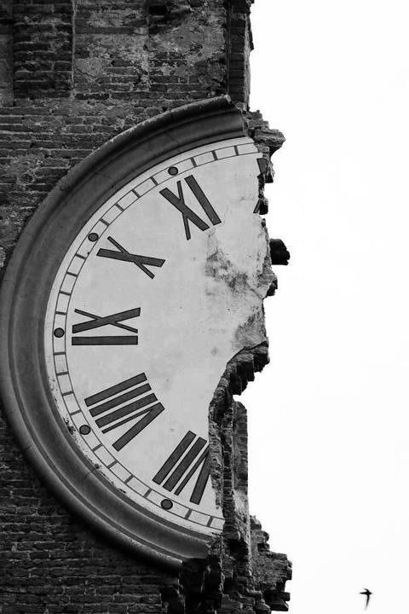
GALATIANS 4:4
“But when the fulness of time came…”
GOD REVEALED HIS TIMETABLE WITH RESPECT TO THE COMING OF THE PROMISED KINGDOM…
Daniel 2:31-45
Daniel 8:20-22
Daniel 11:1ff
NOT during the days of the Babylonian, Medo-Persian nor even the Grecian empires…But in the “days of those kings. Fulness of time: Roman Empire
Pointing to Pentecost- Isaiah 2, Joel 2, Daniel 2
Acts 2:1-5, 14-36
Mark 9:1 Within their lifetime…

Slide 11
EPHESIANS 2:14-16 COLOSSIANS 2:14
“broke down the barrier of the dividing wall”
WHAT JESUS BROUGHT IN WITH THE ESTABLISHMENT OF HIS KINGDOM WAS BETTER…
New King-1Timothy 6:156
New Kingdom-Hebrews 12:28
New Covenant-Hebrews 10:1-4
New Priesthood-Hebrews 7:28-29
STOP AND CONSIDER…
“Now if He were on earth, He would not be a priest at all…” (Hebrews 8:4) The kingdom is spiritual, and was always going to be
Matthew
5:17-18

Slide 12
WEIGH WHAT WOULD HAPPEN IF JESUS SETS FOOT ON EARTH ONCE AGAIN
Hebrews 8:5, 7:14 He WILL NOT be a priest
Ephesians 1:18-21 He would be in an inferior position
Matthew 28:18-20 1Corinthians 15:27 He could not have any more authority than He has now.
“Then we who are alive and remain shall be caught up together with them in the clouds to meet the Lord in the air, and thus we shall always be with the Lord.”
(1Thessalonians 4:17)

Slide 13
SO, WHAT WILL HAPPEN AT CHRIST’S COMING…
1Corinthians 15:22-26
Must Always Remember That No One Knows When The Day Of Christ’s Coming Will Be: Except The Father
Matthew 24:36-2Peter 3:10-11-1Thessalonians 5:2
CHRIST’S COMING v23
THEN COMES THE END v24
WHEN HE DELIVERS UP THE KINGDOM TO THE FATHER v24
WHEN: He shall abolish all authority and power v24
FOR: He must reign, until He has put all His enemies under His feet. The last enemy will be death

